Slide 1
Major endocrine systems for regulation of reproductive processes:

Slide 2
Basic anatomy and physiology
The endocrine system is composed of ductless glands that secrete chemical messenger called hormones in to the blood .
Hormones are chemical substances produced by cells in one part of the body and transported to another part of the body(target organ) where they influence cellular activity
The endocrine system is controlled by a feedback mechanism that includes the hypothalamus , pituitary glands , and the other endocrine glands

Slide 3
Female Feedback Diagram

Slide 4
Male Feedback Diagram

Slide 5
Classification and Properties of Hormone
Chemical Structure
Polypeptides - hypothalamic
Protein - pituitary, gonad
Steroids - gonad, adrenal
Fatty acid - many sources, prostaglandins
Modified amino acid (Amine H.) - derivatives from the amino acid tyrosine –Thyroid, pineal

Slide 6
Hypothalamus hypophysis interrelation

Slide 7
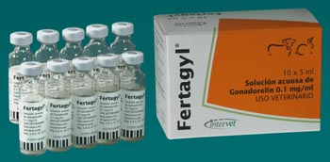
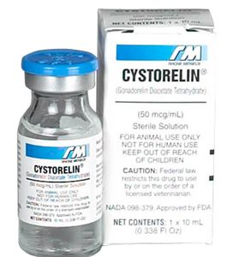
Name of hormone | Biochemical classification | source | Female target tissue | Female primary action | Commercial name
Gonadotropin releasing hormone (GnRH) | neuropeptide | Hypothalamic surge and tonic center | Anterior lobe - pituitary | Release of FSH and LH from anterior lob-pituitary | Fertagyl receptal cystoreline
used 1 – treatment of ovarian follicular cysts. 2 - treatment of inactive ovaries 3 - treatment delayed ovulation or an ovulation. 4 - in Estrus synchronization 5 -Gonadorelin: cow, 0.5 mg i.m., s.c. or i.v. 6- Fertirelin: cow, 100 μg i.m. 7- Buserelin: cow, 10–20 μg; horse 40 μg i.m

Slide 8
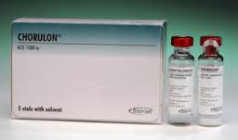
Name of hormone | Biochemical classification | source | Female target tissue | Female primary action | Commercial name
Luteinizing hormone (LH) | glycoprotein | Anterior lobe (pituitary) | Ovary theca interna and luteal cell | Stimulates ovulation , formation of corpara lutea and progesterone secretion | Chorulon follutein
Biological source hCG(human chorionic gonadotropine ) or PLH Used 1 – treatment cystic ovary 2 –before estrous to ovulation , delayed ovulation , anovulation 3 - after insemination to increase size CL to increase progesterone 4 –super ovulation 5 - in embryo transfer to estrous synchronization Dose: 1- Cattle &horse: 1500-3000 IU i.m. 2- Sheep and goat, 100–500 IU i.m. or i.m.

Slide 9
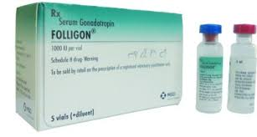
Name of hormone | Biochemical classification | source | Female target tissue | Female primary action | Commercial name
Follicle stimulating hormone (FSH) | glycoprotein | Anterior lobe (pituitary) | Ovary granulosalcells | Follicle development and estradiol synthesis | Folligon Gonadin
Biological source PMSG(pregnant mare serum gonadotropin ) or New name eCG)) PFSH Used 1 –treatment inactive ovaries 2 – super ovulation 3 – estrous synchronization Dose 1 – cattle : 1500- 3000 IU i.m.,s.c. 2 – sheep and goats 500 -800 IU i.m., s.c.

Slide 10
Name of hormone | Biochemical classification | source | Female target tissue | Female primary action | Commercial name
Prolactin | protein | Anterior lobe (pituitary) | Mammary cells | Lactation material behavior | prolactin Bromocriptine (prolactin antagonist)
used 1 – in start and continue the lactation( induce lactation) 2 - maternal instinct and brooding in some species

Slide 11
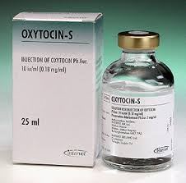
Name of hormone | Biochemical classification | source | Female target tissue | Female primary action | Economic name
oxytocin | neuropeptide | Synthesized in the hypothalamus , stored in the posterior lobe , synthesized by CL | Myometrium and endometrium of uterus myoepithelial cell of Mammary gland | Uterine motility , promotes uterine PGF2 synthesis, milk ejection | Oxytocin pitocin
used 1 – in dystocia 2 – retained fetal membrane 3 –pyometra 4 – milk ejection 5 –induction of abortion in mare Dose: 1- Cattle: 50-100 I.U. 2- Sheep and Goats: 40 I.U.

Slide 12
Oxytocin release

Slide 13
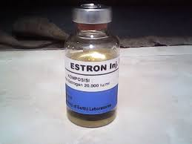
Name of hormone | Biochemical classification | source | Female target tissue | Female primary action | Commercial name
estradiol | Steroid | Granulose cell of follicle ,placenta ,sertoli cells of testis | Hypothalamus , entire reproductive tract and mammary gland | sexual behavior , GNRH, elevated secretory activity of the entire tract, unhanded uterine motility | Estradiol benzoat
used 1 – retained fetal membrane 2 – uterine inflammation 3 – induction abortion 4 – mummified fetuses 5 – prevent fertilization and pseudo pregnancy in bitch dose 1 -15 mg from estradiol 10 -150 mg from stibesterol

Slide 14
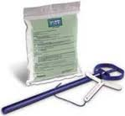
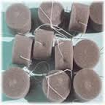
Name of hormone | Biochemical classification | source | Female target tissue | Female primary action | Commercial name
Progesterone | Steroid | Corpus luteum and placenta | Uterine endometrium , mammary gland , myometrium ,hypothalamus | Endometrium secretion, inhibition GNRH release, inhibition reproductive behavior , promotes maintenance of pregnancy | CAP , MAP ,MGA, natural in vaginal device
used 1 – estrous synchronization 2 – treatment repeat abortion 3- decrease signs of estrous in follicular cyst (nymphomania ) use nymphalon (HCG Progesterone )+

Slide 15
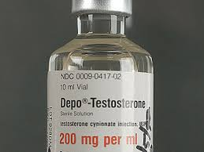
Name of hormone | Biochemical classification | source | Female target tissue | Female primary action | Commercial name
testosterone | Steroid | cells of theca interna | Brain , skeletal muscle , granulosal cells | Substrate for E2synthesis ,abnormal masculinization(hair patterns , voice , behavior ,ect) | Testosteronpropionate
used 1 – preparation teaser in estrous detection 2 – steer fatting (anabolic effect) Dose 50 -500 mg

Slide 16
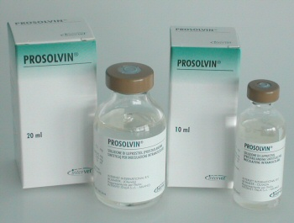
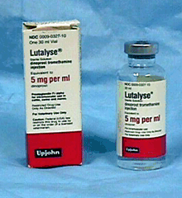
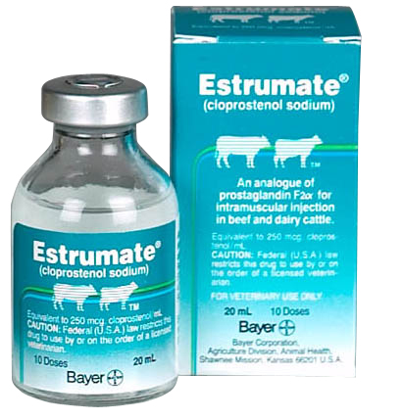
Name of hormone | Biochemical classification | source | Female target tissue | Female primary action | Commercial name
Prostaglandin PGF2< | Fatty acid | Uterine endometrium vesicular glands | Corpus luteum , uterine myometrium, ovulatory follicles | Luteolysis , promotes uterine tone and contrection , ovulation | prosolivin estrumate lutalyse lupnosteole
Used 1 –dystocia (primary uterine inertia) 2 –induction of abortion and parturition 3 – estrous synchronization 4 – treatment pyometra 5 – treatment luteal cyst Dose Cattle:15 – 25 mg Sheep&goats: 7.5 – 10 mg

Slide 17
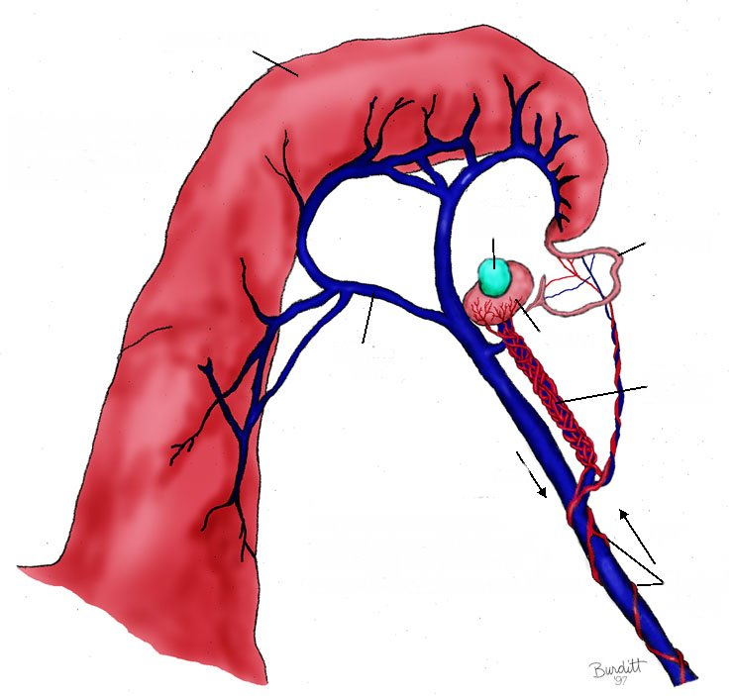
Prostaglandin F2α Control of Luteolysis
Uterine Horn
Progesterone from
CL stimulates
production of
uterine PGF2α after
day 15 in cow
Prostaglandin synthesis
by uterine endometrium
is released into the
uterine vein.
Corpus
Luteum
Oviduct
Ovary
Uterine
Vein
Ovarian Pedicle
PGF
PGF2α is picked up by
ovarian artery through
counter current exchange
and delivered back to the
ovary where it causes
lysis of the CL
PGF into Artery
Uterine Artery

Slide 18
Hormone | Chemical class | Principle function
Humane chorionic gonadotropin (hCG) | Protein | LH -like
Pregnant mare serum gonadotropin (PMSG) or (eCG) | protein | FSH –like, supplementary corpora lutea in mare
Inhibin | protein | Prevent release of FSH
Relaxin | Poly peptide | Expansion of pelvic Dilation of cervix
Adrenal cortex(glucocorticoid ) Cortisol | Steroid | Parturition Milk synthesis

Slide 19
Hormone | Chemical class | Principle function
gonadotropin releasing hormone (GNRH) | Polypeptide | FSH and LH releasing
Prolactin inhibition factor (PIF) | peptide | Prolactin retention
Prolactin releasing factor (PRF) | Peptide | Prolactin release
Corticotropin releasing hormone(CRH) | peptide | ACTH releasing
Adrenocorticotropin (ACTH) | polypeptide | Release of glucocorticoid

